Slide 1
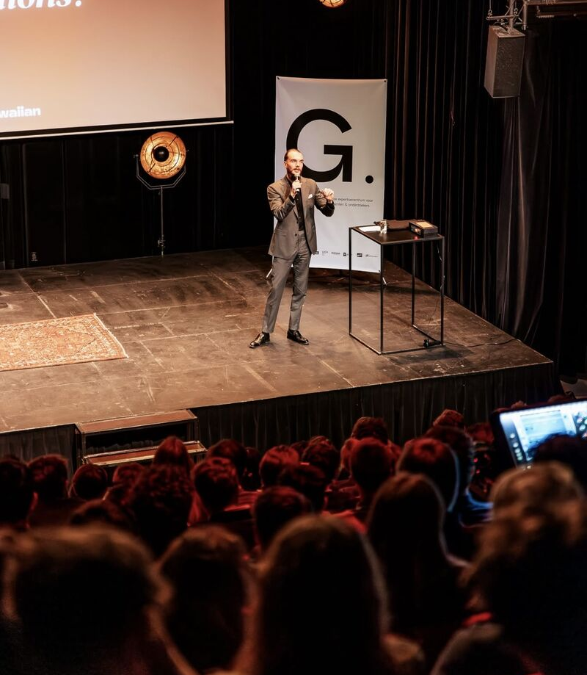
Assignment 1: Lifelong Learning - Seminars

Slide 2
My learning goals for this assignment
I wanted to learn how to best prepare for a successful future career.
One goal was also to understand how to stay consistent and avoid burnout by developing strong habits for success.
Lastly, I wasn’t looking for just theories or textbook advice, but I wanted to hear real-life experiences from someone who has actually achieved success and learn from their journey.
Tried to look for seminars which have links to IBM

Slide 3
My seminars
Salary, Salary Calculations and Salary Negotiations for a First Job
Feby De Maeyer (and Mare Eykens), 5 December 2024 at Artevelde campus
LinkedIn as a tool for job hunting and the ValueFit tool
Feby De Maeyer (and Mare Eykens), 13 February 2025 at Artevelde campus
Gentrepreneur
Mattijs Hermans, 18 February 2025 at ‘De centrale’
Start a business using AI to create an easy income working from home in 2025
Joy Mallard, 13 March 2025 online
Success habit online - Masterclass
Tilman Resh, 20 March 2025 online

Slide 4
1. Salary, Salary Calculations and Salary Negotiations for a First Job

Slide 5
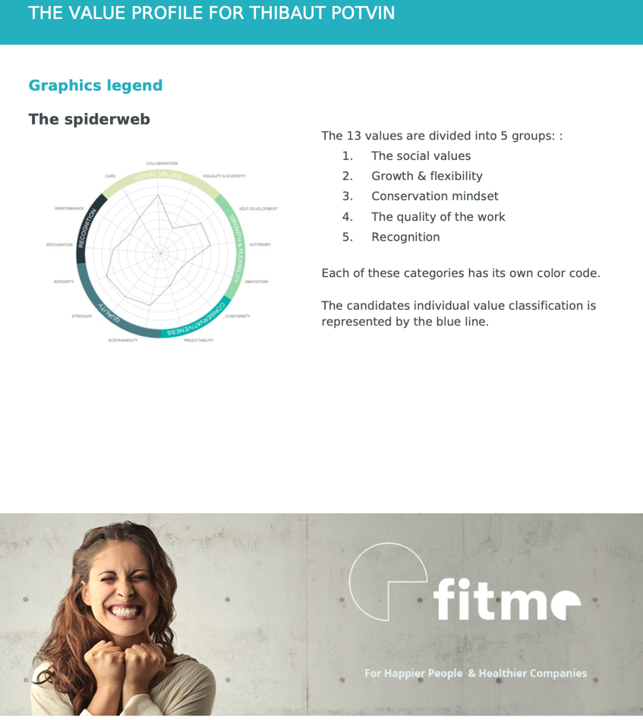
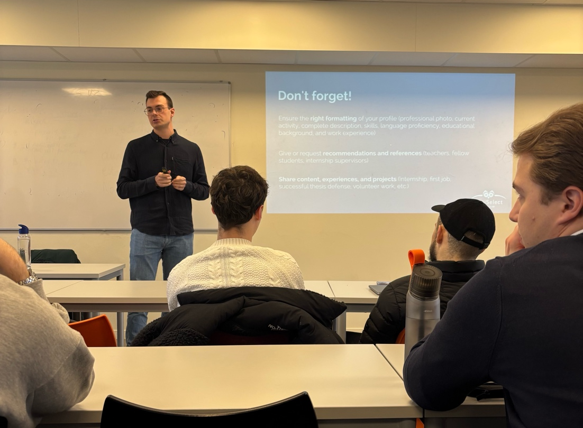
2. LinkedIn as a tool for job hunting and the ValueFit tool

Slide 6
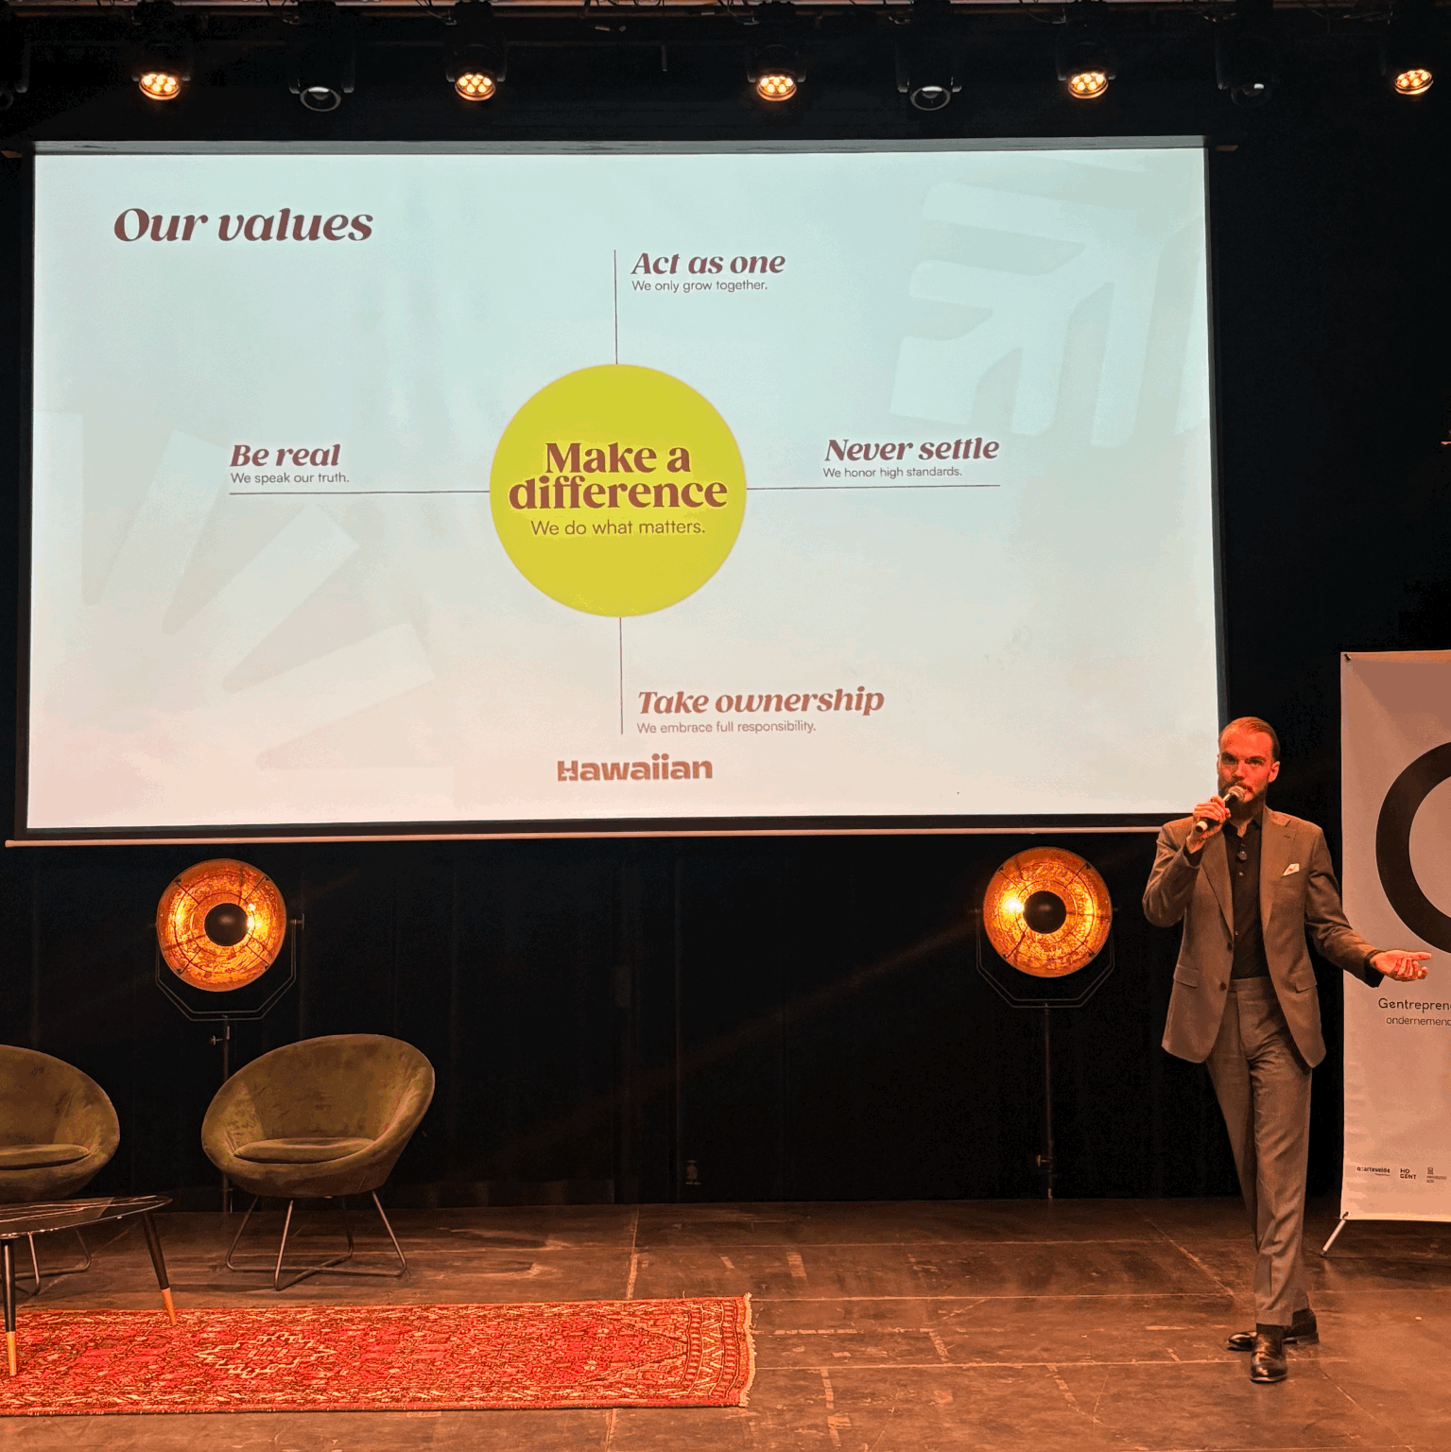
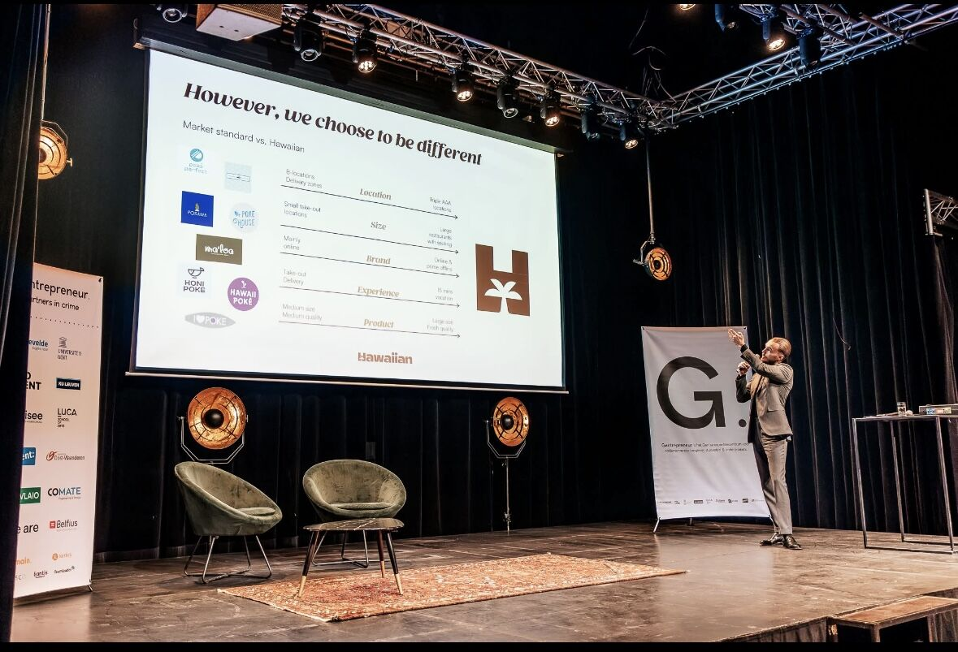
3. Gentrepreneur

Slide 7
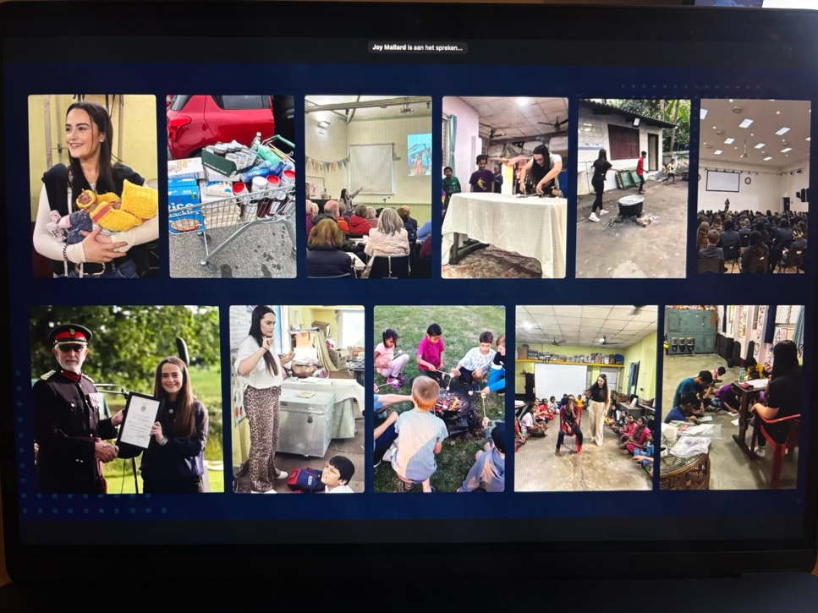
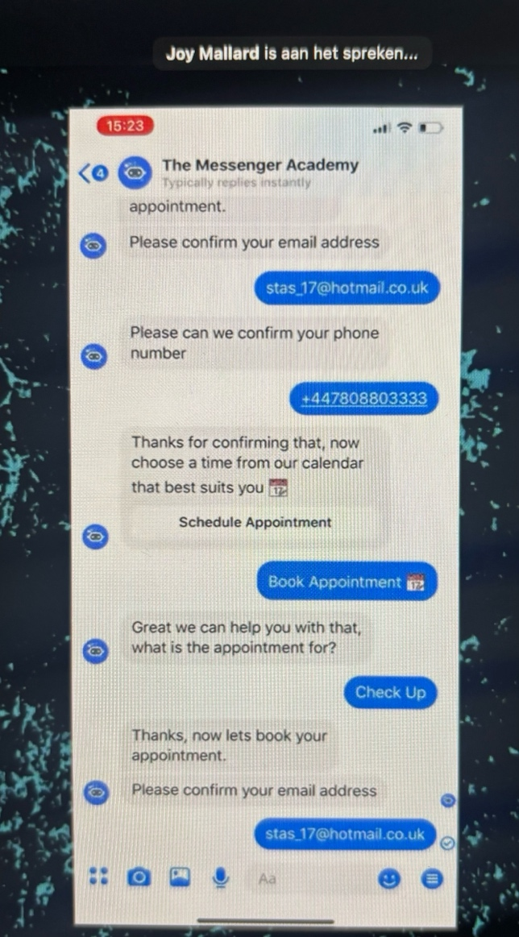
4. Start a business using AI to create an easy income working from home in 2025

Slide 8
5. Success habits Online - Masterclass

Slide 9
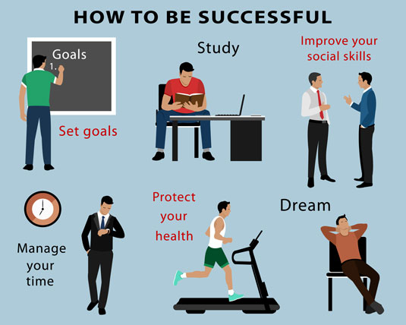
Own research on the topic of one presentation
-> Success habits
Organisation & Time Management
Mental & Physical Well-being
Taking Action & Setting Goals
Positive Mindset & Gratitude
Continuous Learning
Morning Routines & Early Rising
Networking & Relationships
Frugality & Financial Literacy
Giving Back
Purpose & Vision
Resilience & Adaptability
Work-Life Balance

Slide 10
Sources of the research
Dhir, R. (2025, March 3). 10 Habits of successful people and how you can boost your bottom line. Investopedia. https://www.investopedia.com/articles/personal-finance/092515/10-habits-successful-people.asp
Harroch, R., & Harroch, D. A. (n.d.). The top 10 habits of highly successful people according to AI. TIME. https://time.com/partner-article/7270431/the-top-10-habits-of-highly-successful-people-according-to-ai/
Mbonigaba, C., & Vanitha, N. (2018). Ten Essential Habits of Successful Entrepreneurs: A guide for the next generation. In International Journal of Applied and Advanced Scientific Research (Vol. 3, Issue 2, pp. 56–64) [Journal-article]. https://d1wqtxts1xzle7.cloudfront.net/119480144/2018_56_64-libre.pdf?1731287760=&response-content-disposition=inline%3B+filename%3DTEN_ESSENTIAL_HABITS_OF_SUCCESSFUL_ENTRE.pdf&Expires=1744203498&Signature=ErU5DruhoNcDC90LJXNlVd1oJw7pvl3X7sbgg56nP5s5bKRbXh42ZIwSudsZ0OvC0wK373YOHF7IF5vR7tP49gtd~5LomGMfjcGNINjSC41cTQlWRLPlAuTPssubNPf0O2HpYQi4~N2OEFPRSnpFR0Q6VuSKMp-WtDc~ylrJWqJi6hZ-LO9MRghcqLqaIKDgpfQUYusF~n0N90mnw1LhZymAosYjid48df6b1H5jPDIBfHLvm9jgjTnQgHZKOcxGIct7fL4bxnUQAFswXjCeRkSZW-Q66Py5iuGbvfCs4Laituq1PlqJDECvN~FwBp~gMtVIz2hnjyRQcwQ7SgdAIQ__&Key-Pair-Id=APKAJLOHF5GGSLRBV4ZA

