Slide 1
My Growth Story
Notes:
Hello and welcome to my growth story.
So In this presentation i will talk about some of my learning outcomes, show you some visuals, tell u about my strengths and weaknessses and lastly 1 self-regulating learning skill from the Zimmerman Model

Slide 2
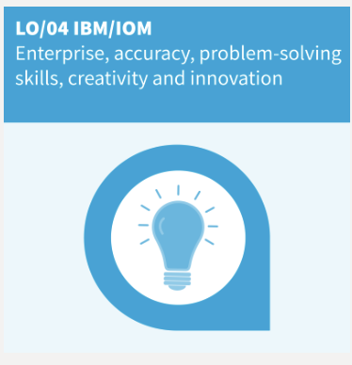
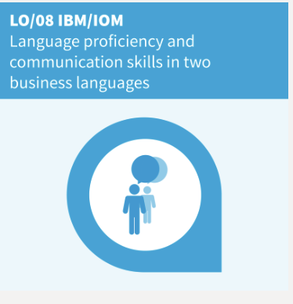
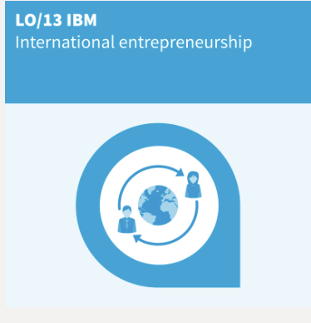
My learning outcomes
Notes:
So, for the first learning outcome, I have succeeded in this by going to seminars as well as building my leadership and organisational skills by doing groupworks
For the second learning outcome, I have worked on this by doing my best for the business case of Nokia. For the creativity and innovation part, I will need to use it in my last sprint because we will have to come up with some alternatives to the products we are working on for global marketing and trade.
Learning outcomes 8 about language proficiency and communication skills in two business languages was also important for me this year. For example for english I have used this on my study trip to Chicago because there i had to use business languages when meeting officials of the companies we visited. For french i also wanted to focuss because last year i only had a 12 out of 20 for my examens and i wanted to improve this that is why i studied more went to all the classes and did my best on the assignments and now i got a 15 out of 20 and I’m very happy about this
For the last learning outcome, I think that when studying IBM, this should be a reason why you choose IBM. For example, I have worked on different courses with team members who were from different countries but also when going on the study trip, as I already mentioned, I met new people from different places in the world. Also, with the international day we had at our campus, we also learned about different countries and how they do business.

Slide 3
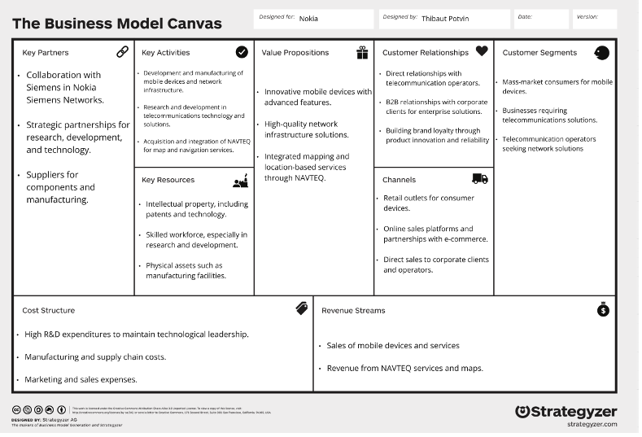
Notes:
So here are so pitcures that match my learning outcomes.
So on top you can see my improvement of my points for french
Then on the left you can see the business model canvas that we made for Nokia
And on the right yo can see a picture from when we vistited the company flanders investment and trade.

Slide 4
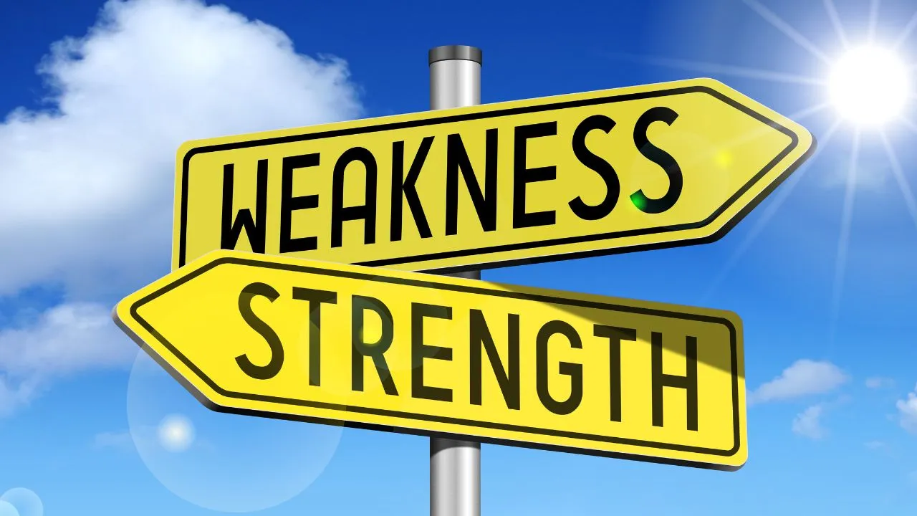
Strengths and weaknesses
Notes:
So then we had to talk about our strengths and weaknesses which we identified in the first year.
Strengths: see bigger picture, social person, if i want something i would but a lot of afford into it
Weaknesses: annoyed fast, egoistic, too impulsive, not listing to other people’s points of view
And i think most have stayed the same but some weaknessses have changed. not listing to other people’s points of view and being egoistic

Slide 5
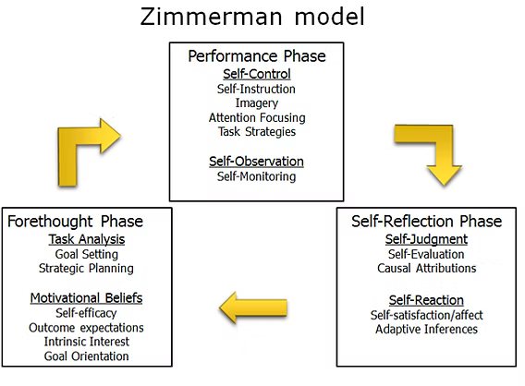
1 self-regulating learning skill from the Zimmerman Model
Performance phase
Implement learning strategies
Monitor progress
Make adjustments
Notes:
I choose this skill to still develop in my academic year because I think this is the most important one. If you are able to implement learning strategies, monitor the progress, and make adjustments if necessary, I think you can face a lot of challenges because witht this learning skill you know how to handle them.

