Slide 1
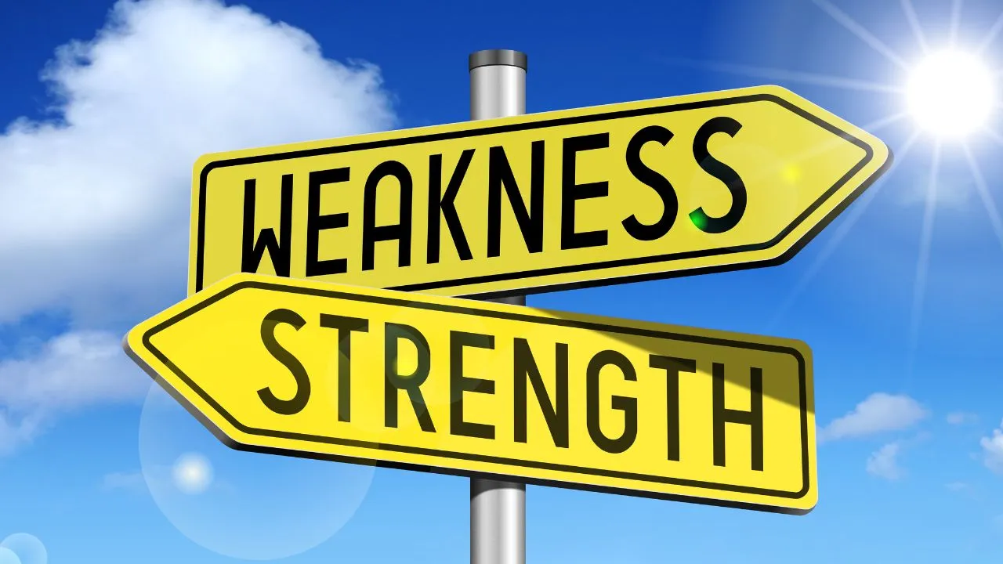
Strengths and weaknesses
Notes:
So then we had to talk about our strengths and weaknesses which we identified in the first year.
Strengths: see bigger picture, social person, if i want something i would but a lot of afford into it
Weaknesses: annoyed fast, egoistic, too impulsive, not listing to other people’s points of view
And i think most have stayed the same but some weaknessses have changed. not listing to other people’s points of view because now i see how people perception of things can also improve the way you see things.

