Slide 1
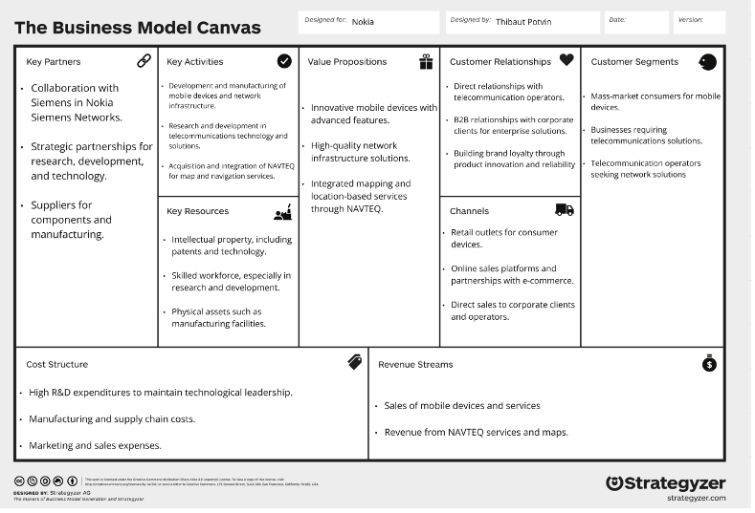
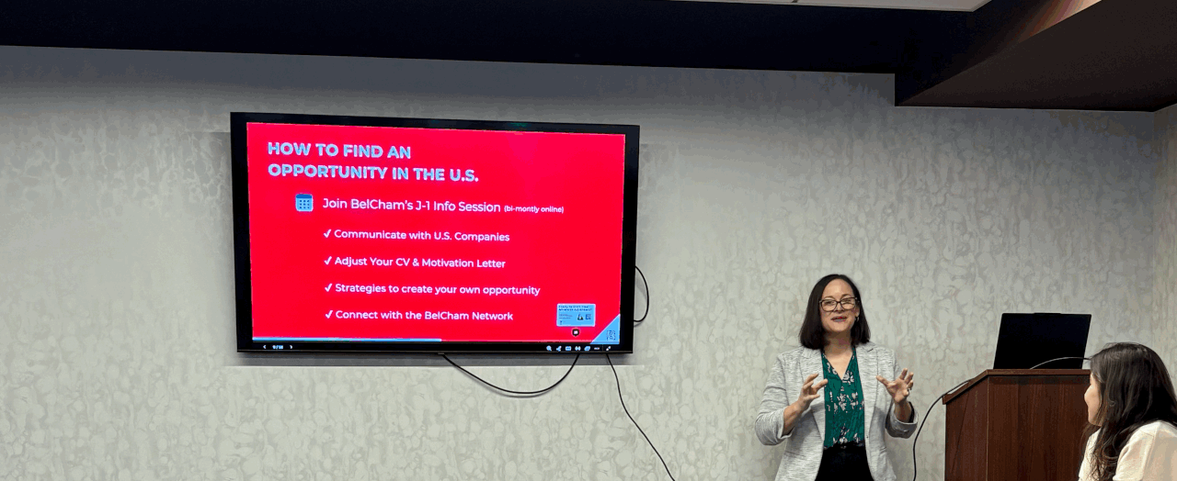
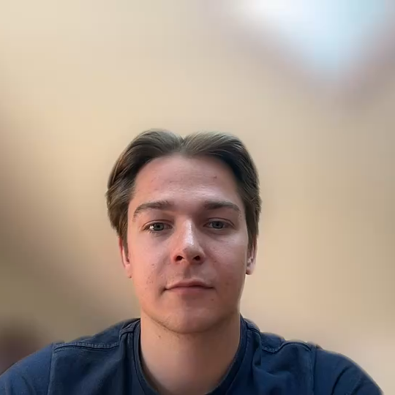
Notes:
So here are so pitcures that match my learning outcomes.
So on top you can see my improvement of my points for french
Then on the left you can see the business model canvas that we made for Nokia
And on the right yo can see a picture from when we vistited the company flanders investment and trade.

