Slide 1
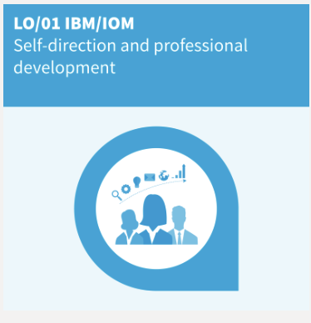
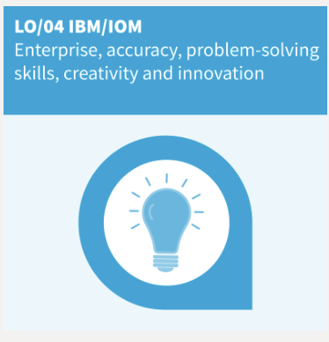
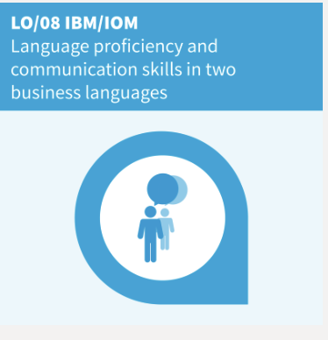
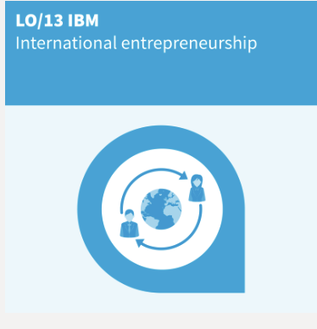

My learning outcomes
Notes:
So, for the first learning outcome, I have succeeded in this by going to seminars as well as building my leadership and organisational skills by doing groupworks
For the second learning outcome, I have worked on this by doing my best for the business case of Nokia. For the creativity and innovation part, I will need to use it in my last sprint because we will have to come up with some alternatives to the products we are working on for global marketing and trade.
Learning outcomes 8 about language proficiency and communication skills in two business languages was also important for me this year. For example for english I have used this on my study trip to Chicago because there i had to use English when meeting officials of the companies we visited. I also wanted to focuss on french because last year i only had a 12 out of 20 for my examens and i wanted to improve this that is why i studied more went to all the classes and did my best on the assignments and now i got a 15 out of 20 and I’m very happy about this
For the last learning outcome, I think that when studying IBM, this should be a reason why you choose IBM. For example, I have worked on different courses with team members who were from different countries but also when going on the study trip, as I already mentioned, I met new people from different places in the world. Also, with the international day we had at our campus, we also learned about different countries and how they do business.

