Slide 1
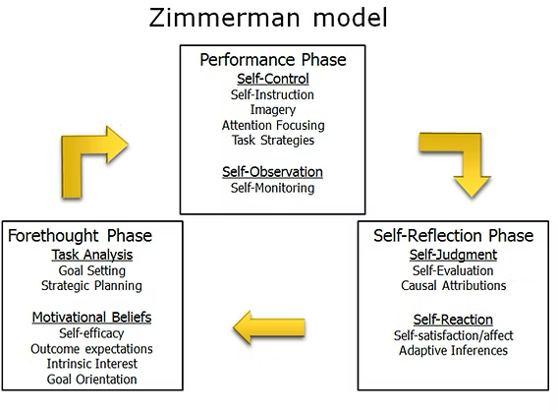

1 self-regulating learning skill from the Zimmerman Model
Performance phase
  Implement learning strategies
  Monitor progress
  Make adjustments
Notes:
So lastly we had to chose …, and I choose this skill to still develop in my academic year because I think this is the most important one. If you are able to implement learning strategies, monitor the progress, and make adjustments if necessary, I think you can face a lot of challenges because with this learning skill you will know how to handle these problems.

